Slide 1
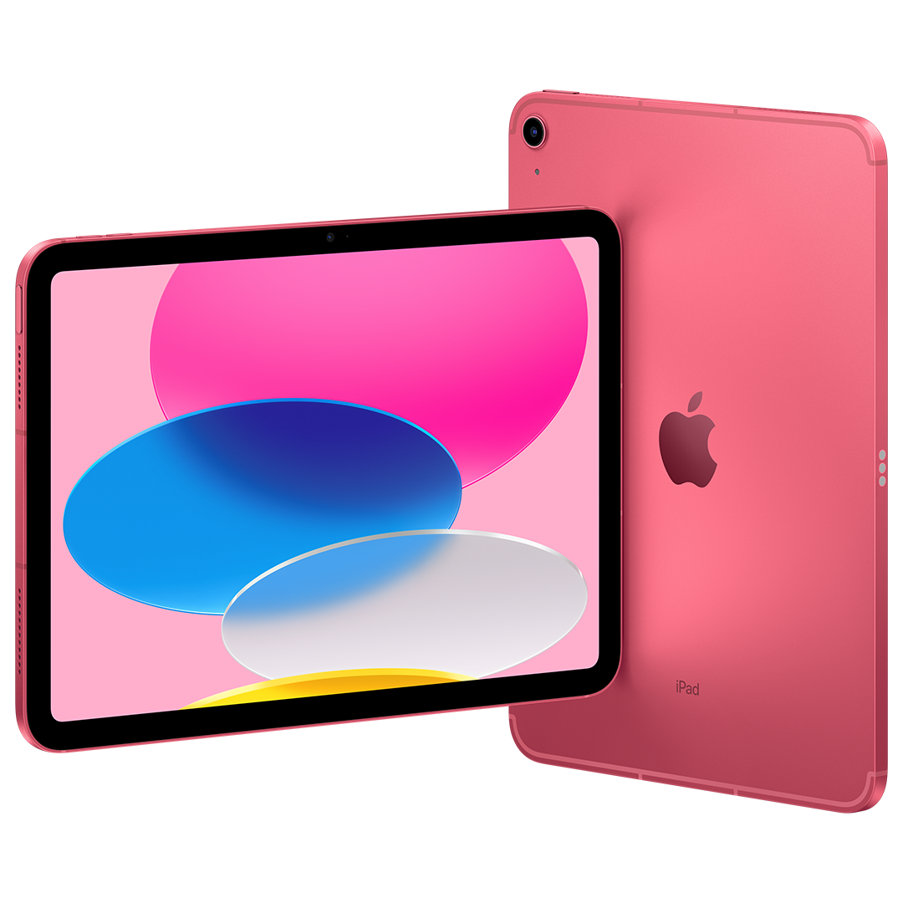
Welcome to the
DREAMS Lab!
iPads

Slide 2
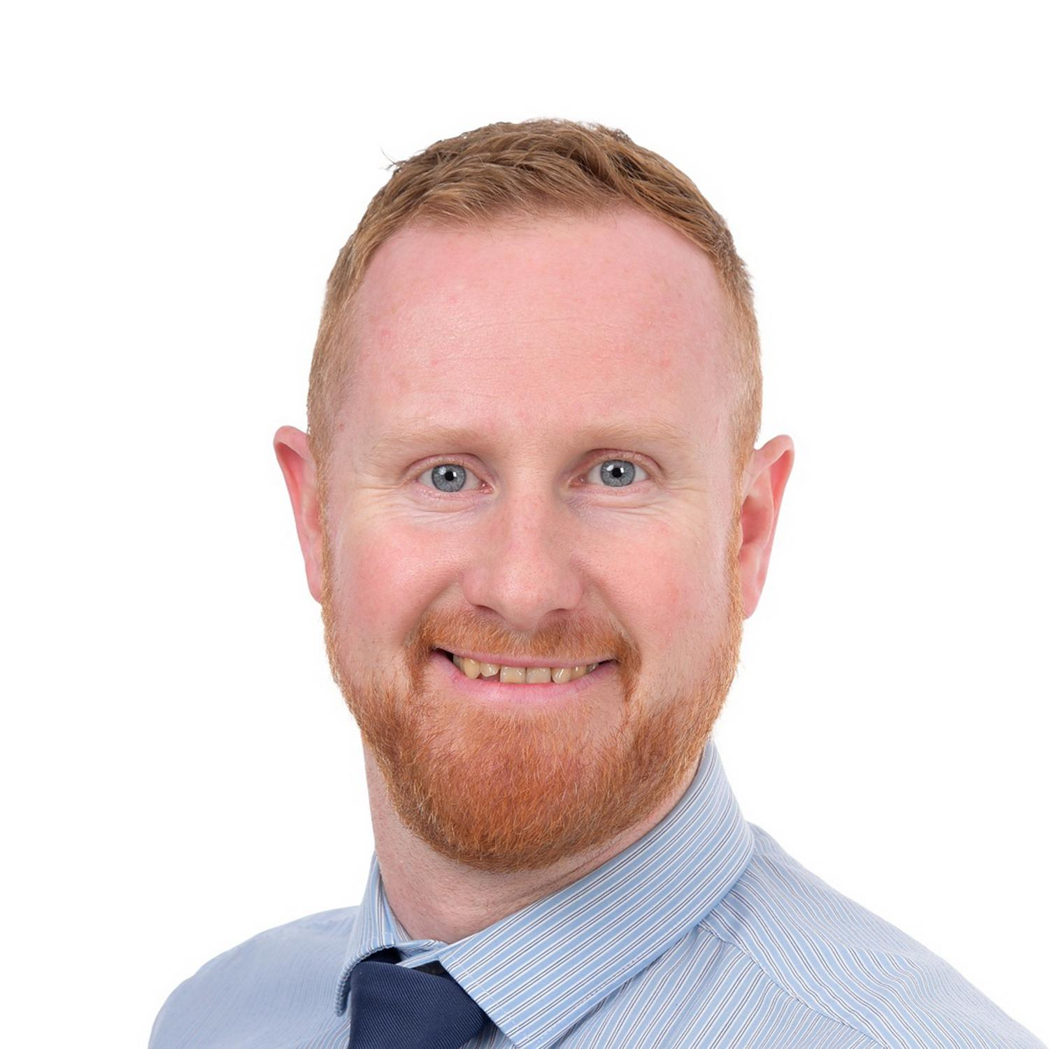
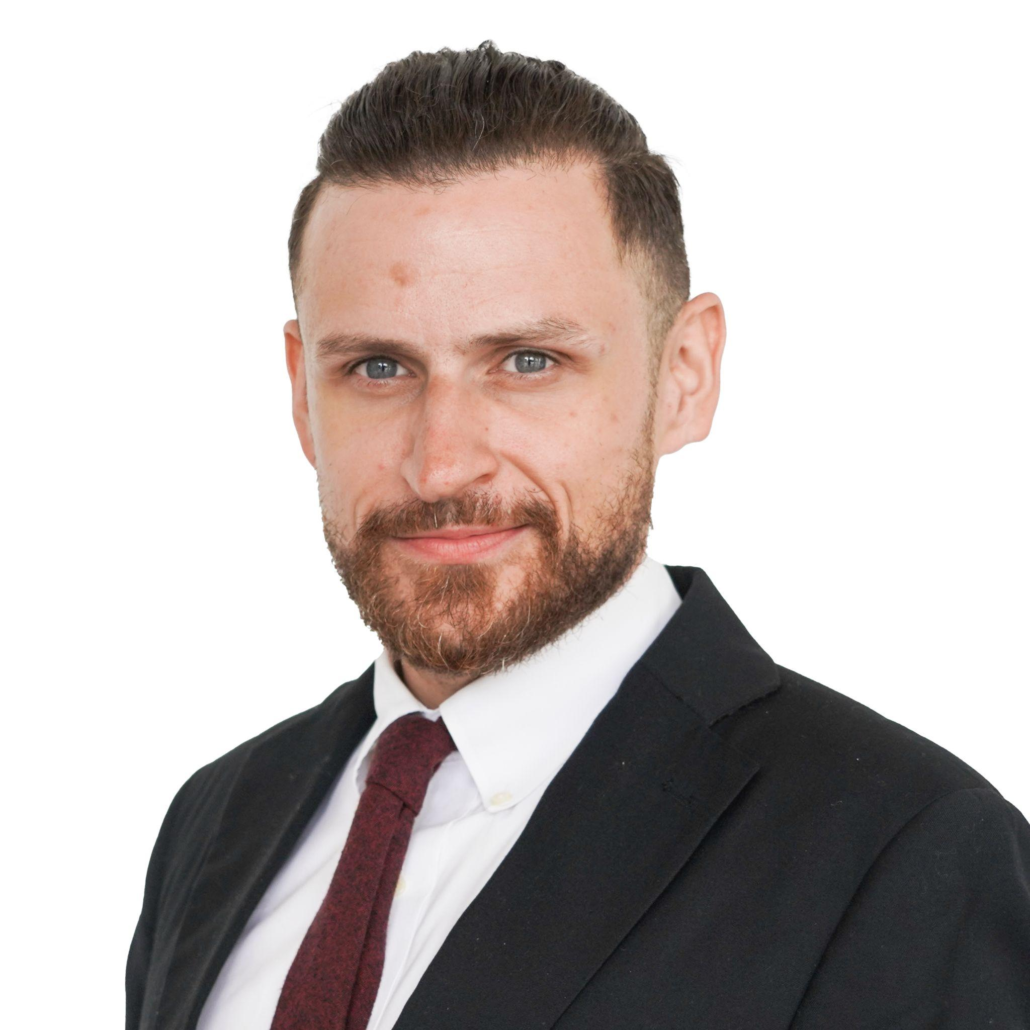
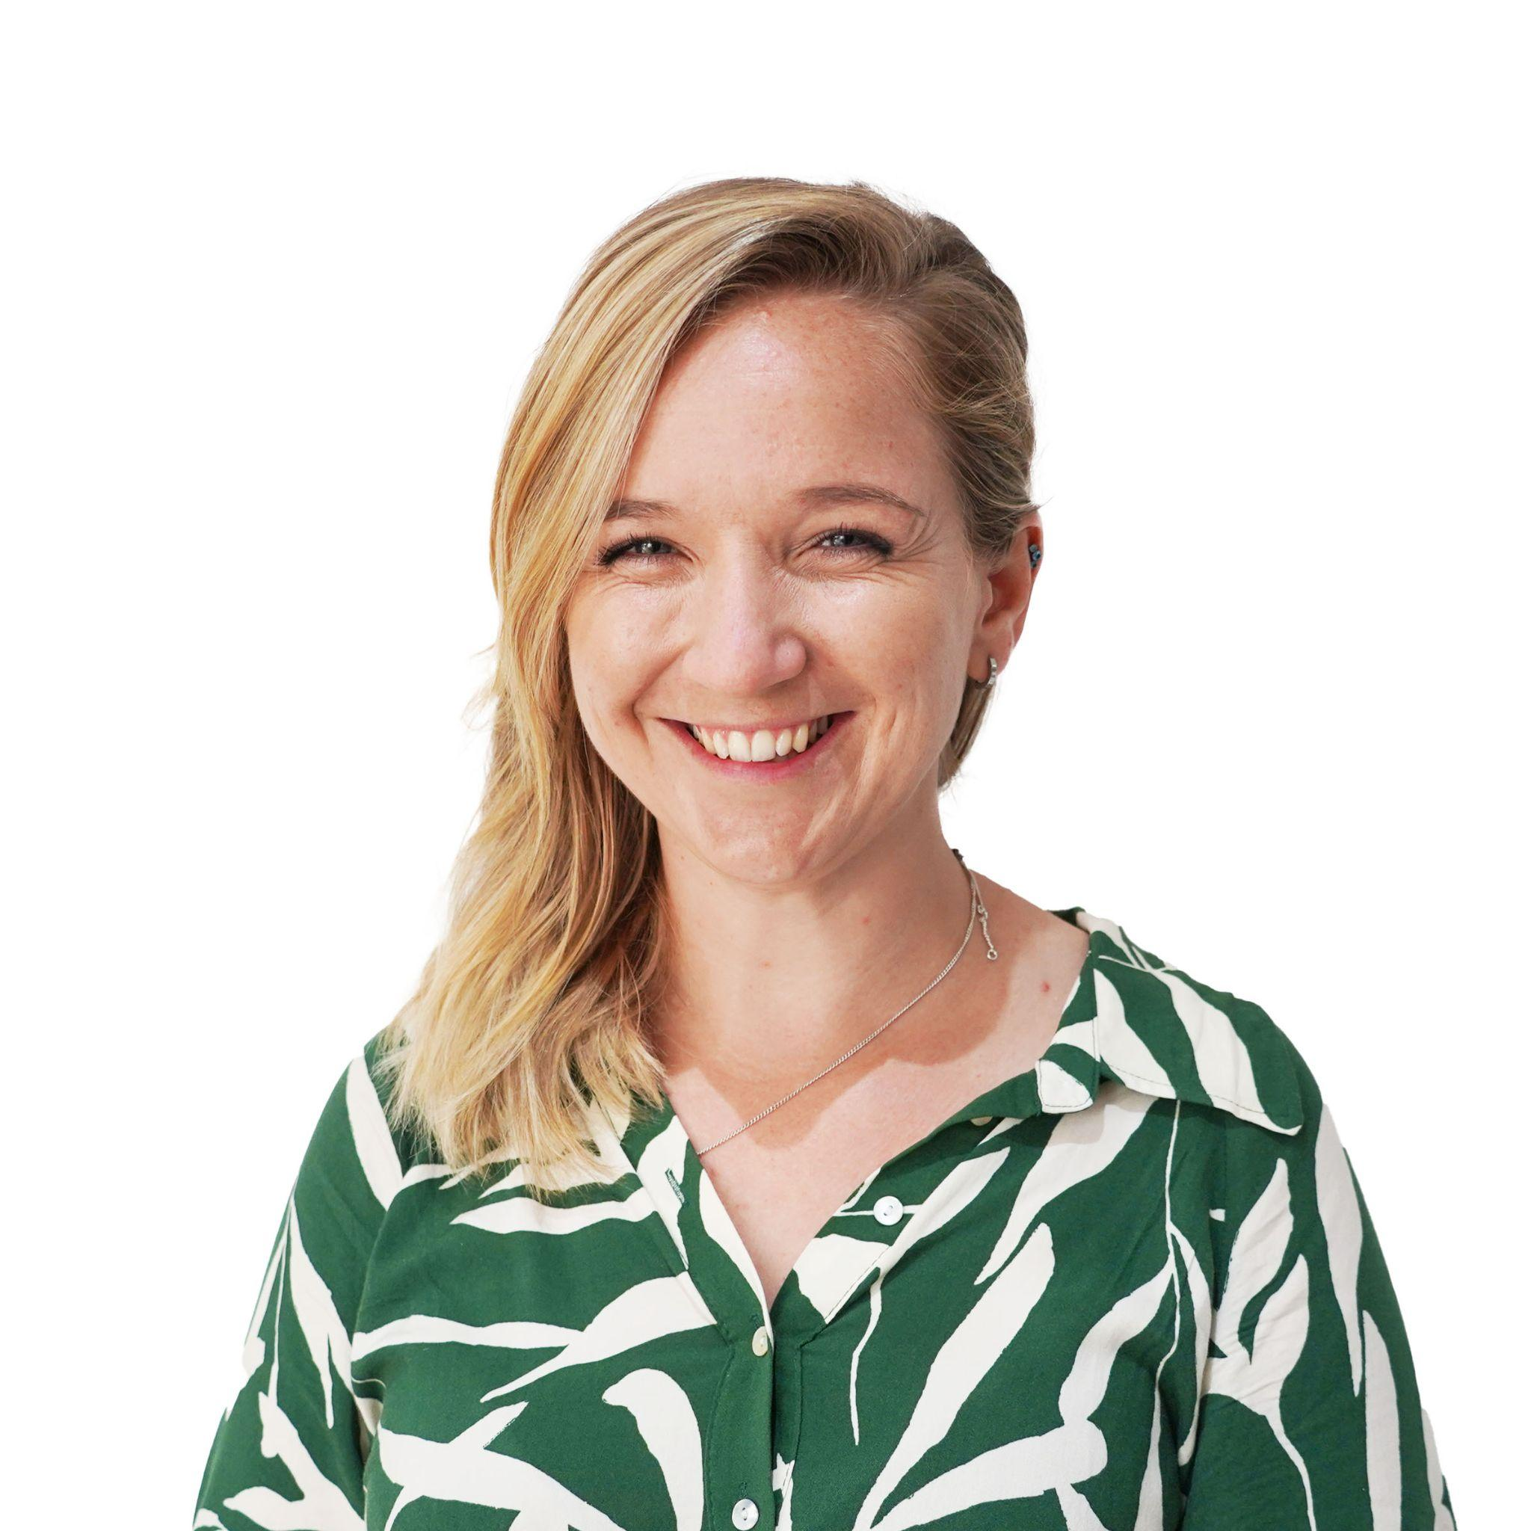
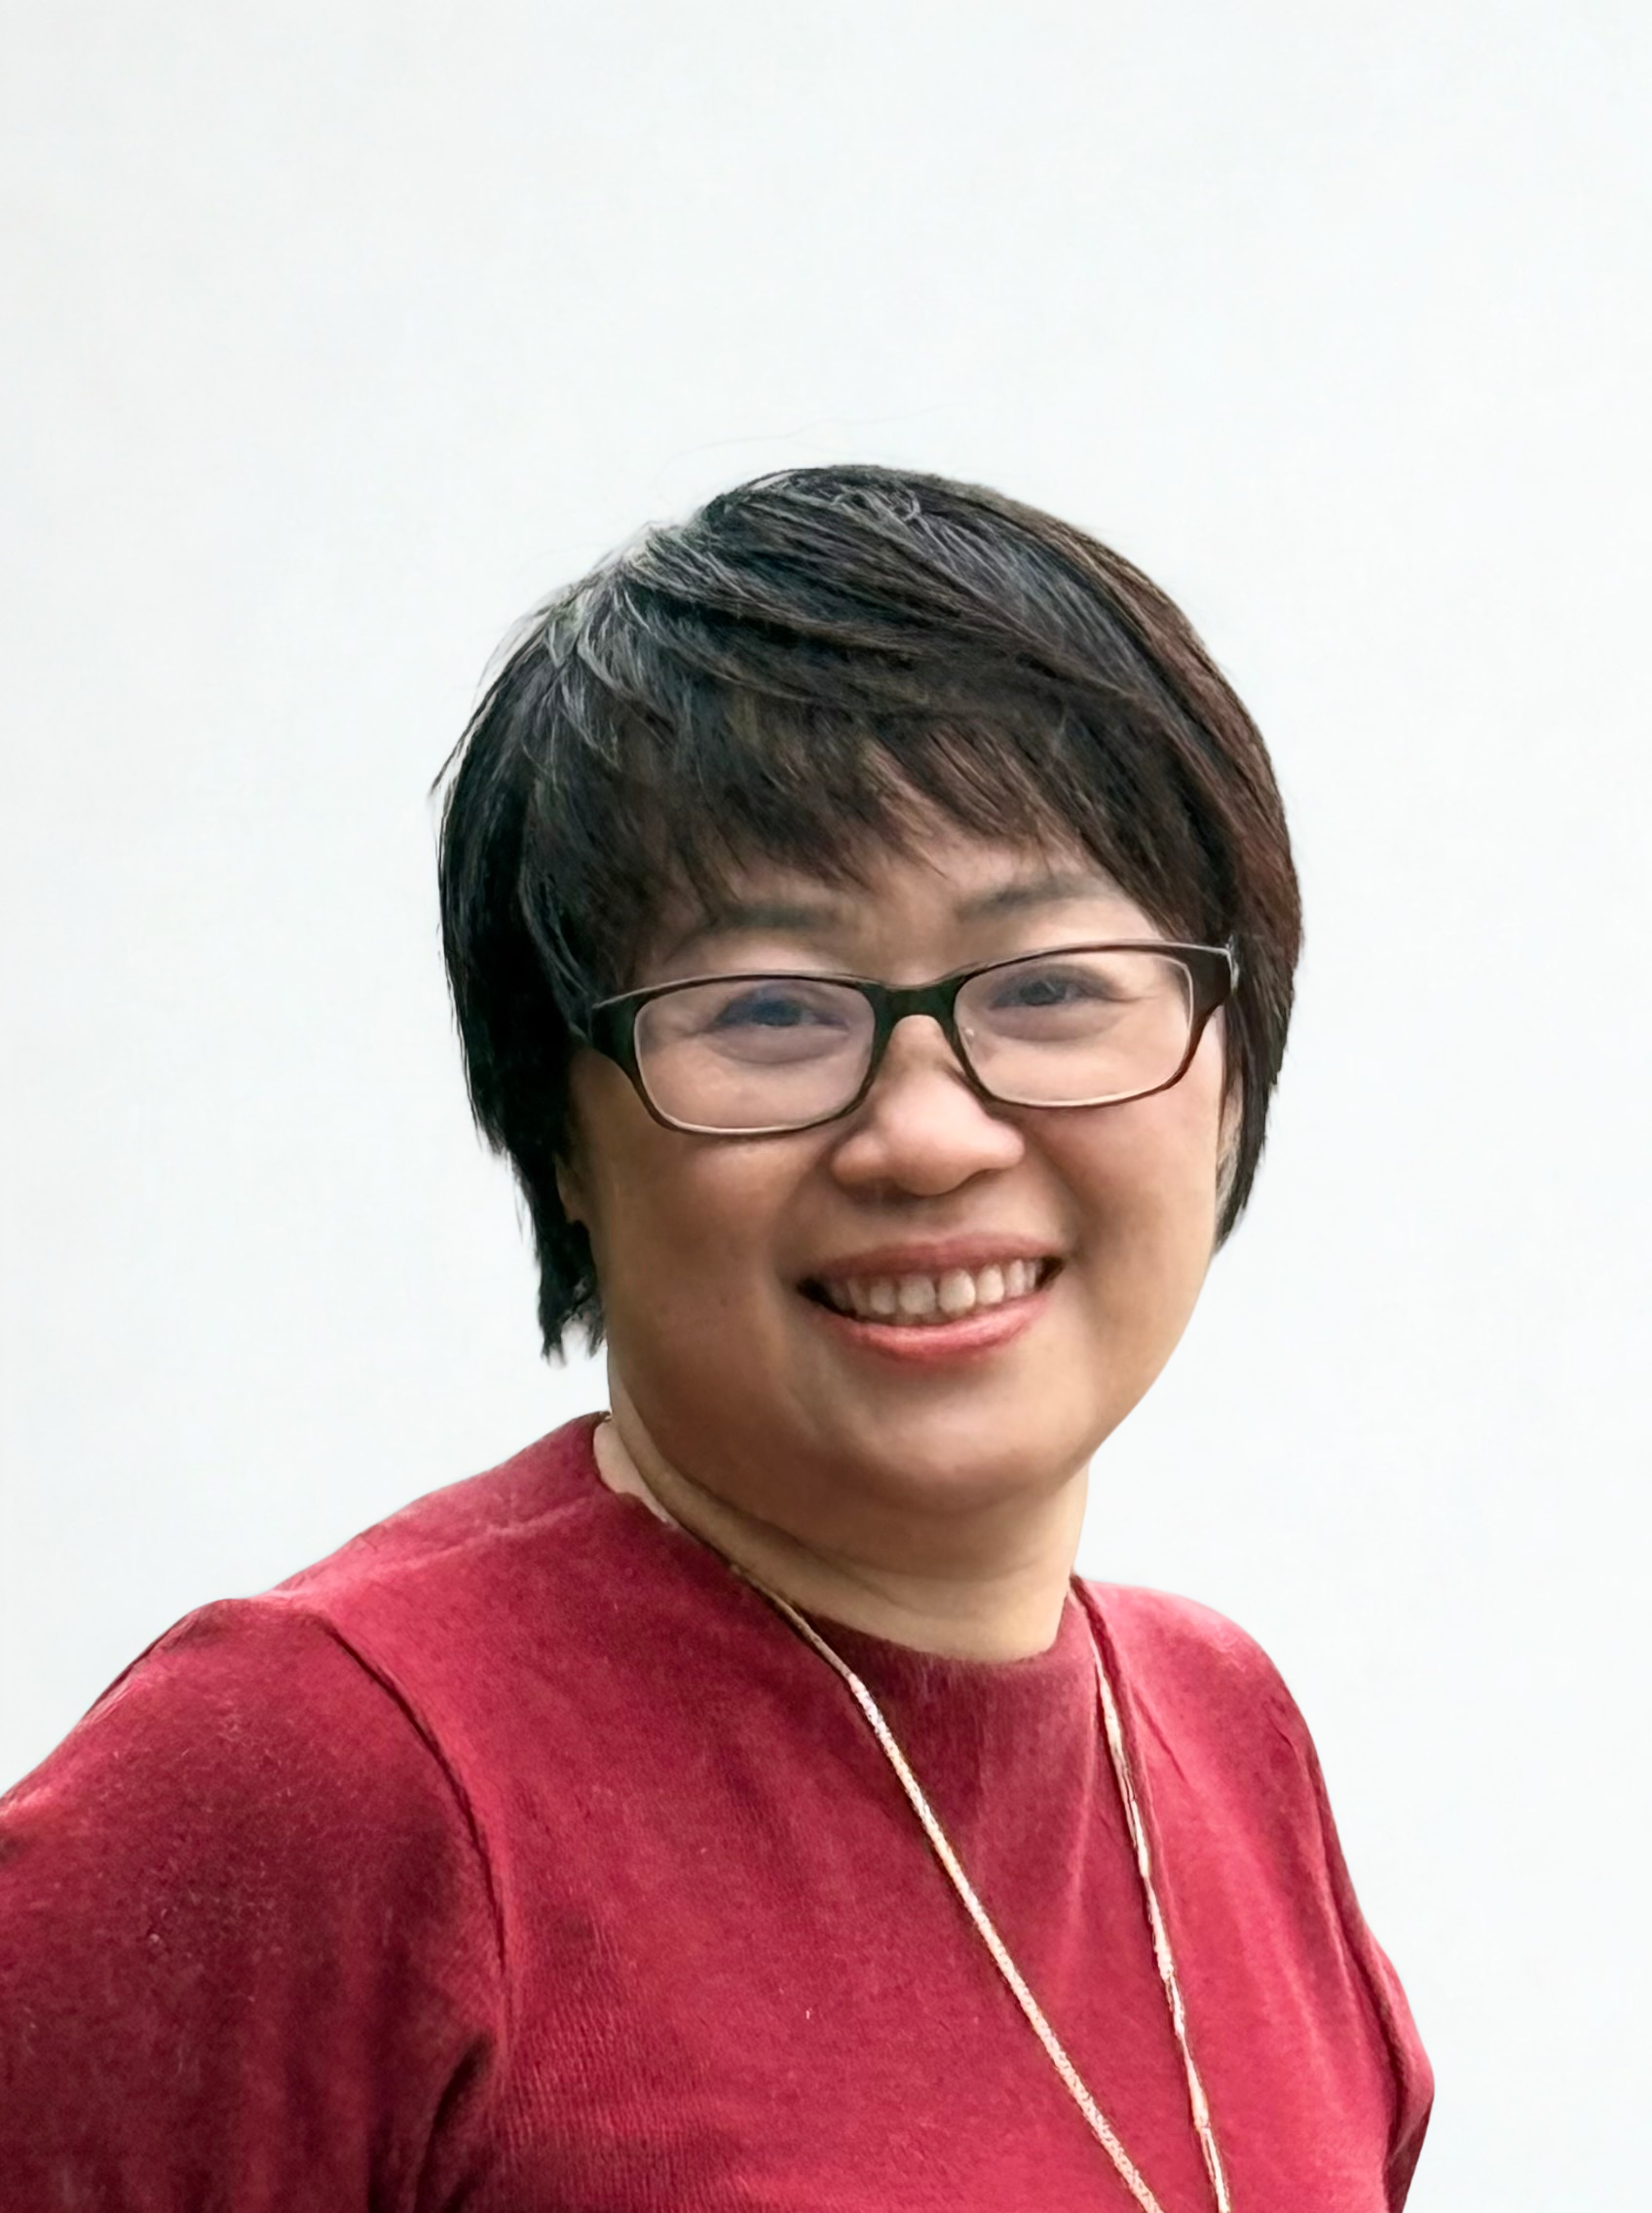
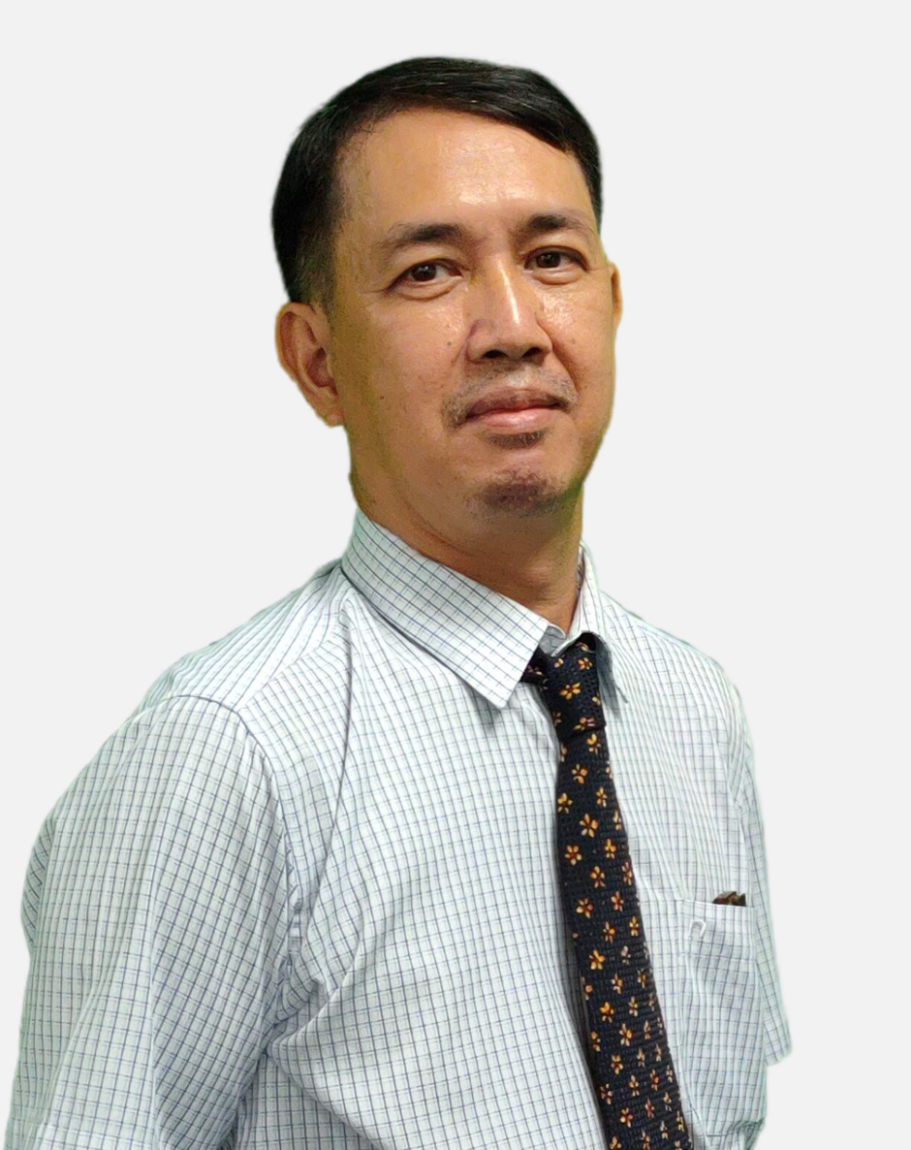
Meet the team
Mr Anthony
Head of ICT
Mr Patrick
Ms Rhian
Mr Tue
Ms Uyen

Slide 3

What do these look like in the DREAMS
Labs?

Slide 4
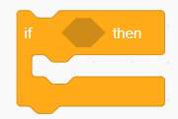
Dreams Lab Expectations

Slide 5

If…then…
…I should play on my iPad.
…I should speak loudly to my friends.
If I am waiting outside for my teacher, then….
…I should wait quietly against the wall.
…I should just go in and wait inside.
Notes:
Can stand up and go to the corner, nominate one person from each table to go to the corner or just point to the corner… depends on energy of class

Slide 6
If…then…
…. Sit and wait for someone to help me
…. I should play a random game on my iPad
If I am stuck and I don’t know what to do next, then….
….. Go and ask my Class teacher
…. C3 B4 Me
(ask 3 friends for help before asking your ICT Teacher)

Slide 7
If…then…
…. I will put my headphones in and stay quiet
…. I will stay quiet and let everyone else do the work
If I am asked to work with a partner or in a group, then….
…. I will listen to everyone and make sure everyone is involved
…. I will do all the work myself

Slide 8
If…then…
… my ICT teacher will give me 2 warnings before I need to sit out of the learning.
…. My parents will be asked to come in to school
If I am not showing respect, care and showing I am ready, then….
….. I can sing
…. I don’t need to listen in ICT, it’s ok

Slide 9

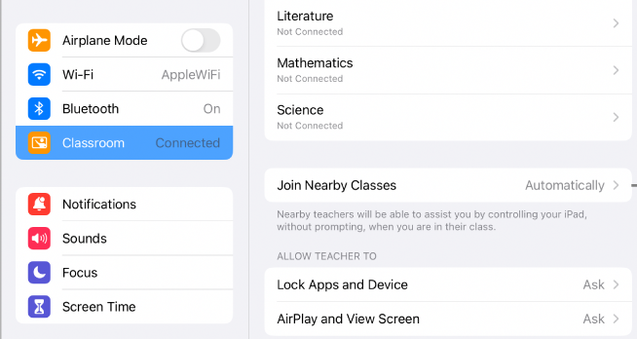
Setting up Apple Classroom
Turn WIFI on and connect to ‘EDUCATION’ network
Go to settings and look for the logo
Tap blue words Add/ join class e.g ‘3B ICT Mr Anthony’
Notes:
Student’s may not know their passwords yet. Provide them with the excel doc when provided by Maria

Slide 10
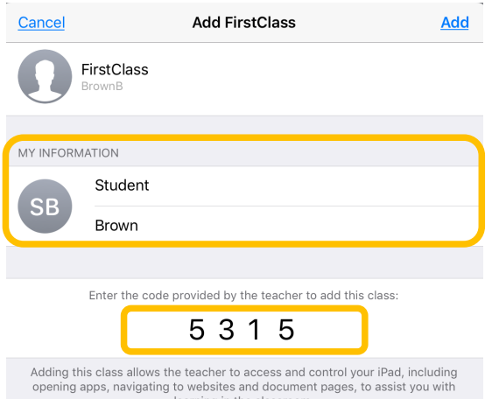
Setting up Apple Classroom
Enter the code you see on the screen
Write your first and last name
Tap add
ALLOW ALL permissions
Wait for teacher
X X X X
Notes:
Student’s may not know their passwords yet. Provide them with the excel doc when provided by Maria

Slide 11

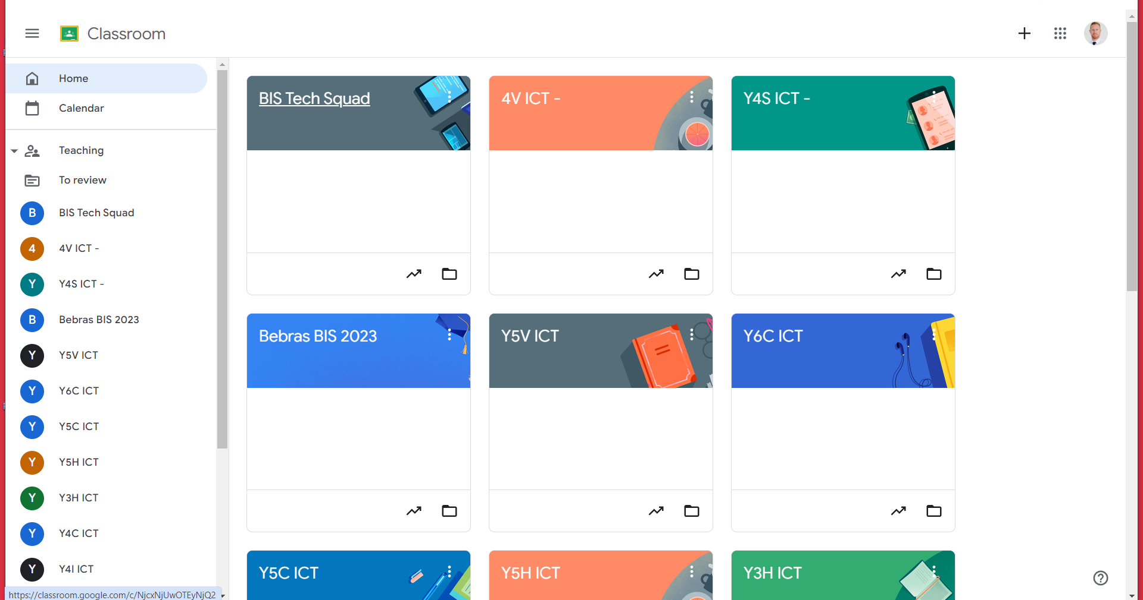
Join Google Classroom
Join Class

Slide 12
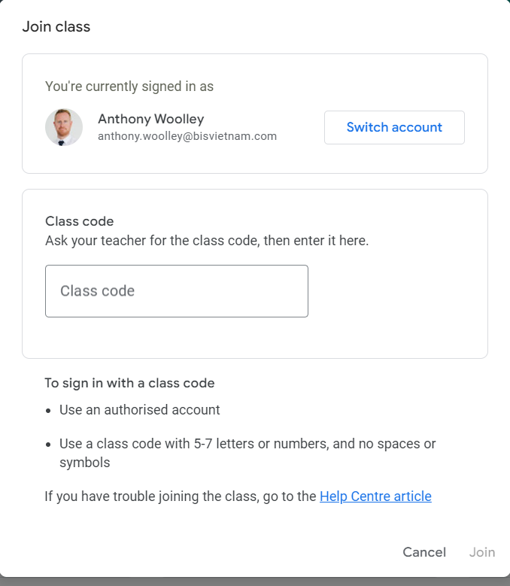
Enter class code

Slide 13
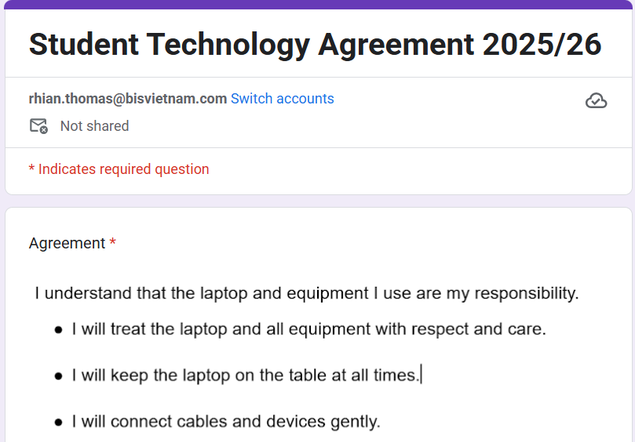
Agree and sign on Google Forms

Slide 14
Notes template

Slide 15
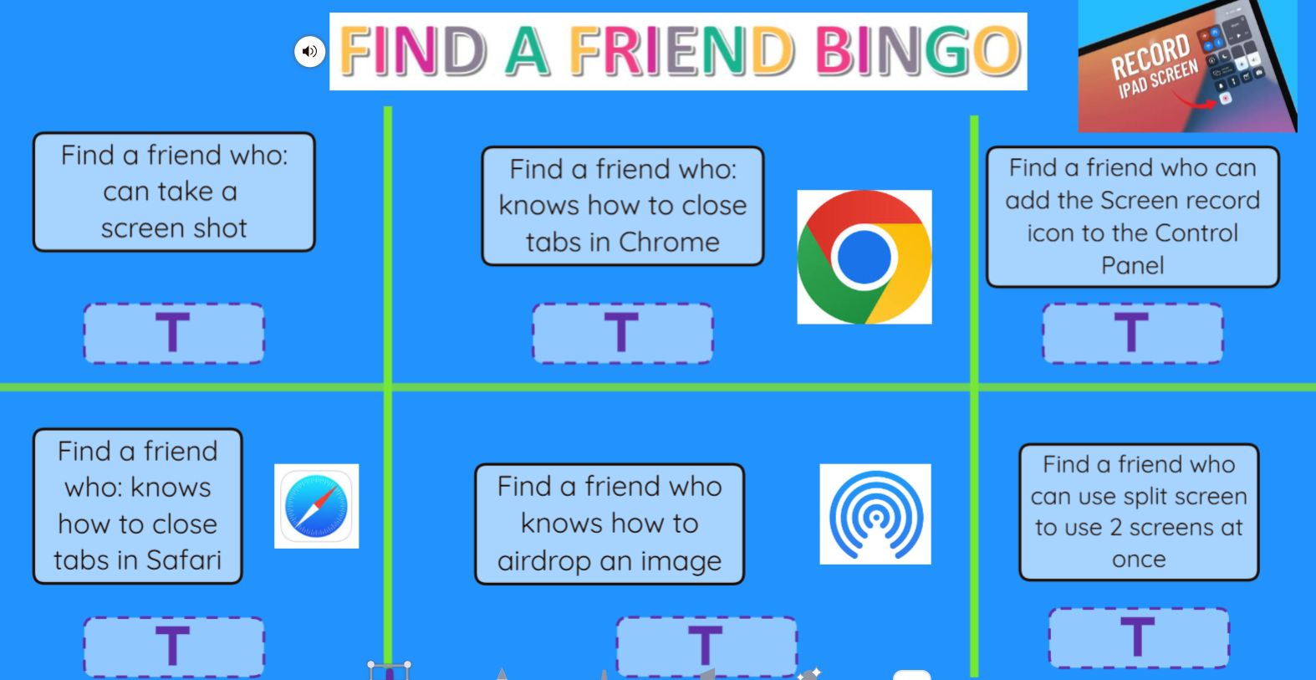
Notes:
Seesaw link

Slide 16
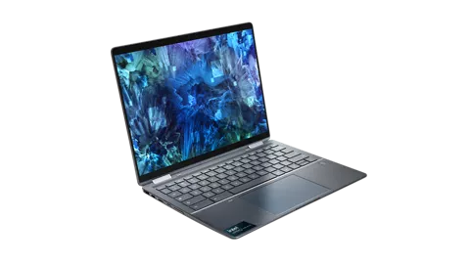
Welcome to the
DREAMS Lab
Laptops

Slide 17
Meet the team
Mr Anthony
Head of ICT
Mr Patrick
Ms Rhian
Mr Tue
Ms Uyen

Slide 18
What do these look like in the DREAMS
Labs?

Slide 19
Dreams Lab Expectations

Slide 20
If…then…
…I should play on my iPad.
…I should speak loudly to my friends.
If I am waiting outside for my teacher, then….
…I should wait quietly against the wall.
…I should just go in and wait inside.
Notes:
Can stand up and go to the corner, nominate one person from each table to go to the corner or just point to the corner… depends on energy of class

Slide 21
If…then…
…. Sit and wait for someone to help me
…. I should play a random game on my iPad
If I am stuck and I don’t know what to do next, then….
….. Go and ask my Class teacher
…. C3 B4 Me
(ask 3 friends for help before asking your ICT Teacher)

Slide 22
If…then…
…. I will put my headphones in and stay quiet
…. I will stay quiet and let everyone else do the work
If I am asked to work with a partner or in a group, then….
…. I will listen to everyone and make sure everyone is involved
…. I will do all the work myself

Slide 23
If…then…
… my ICT teacher will give me 2 warnings before I need to sit out of the learning.
…. My parents will be asked to come in to school
If I am not showing respect, care and showing I am ready, then….
….. I can sing
…. I don’t need to listen in ICT, it’s ok

Slide 24
Check the Classroom Screen to see your Laptop Number!

Slide 25

Open the lid, don’t turn it on yet!
Notes:
Display Laptop number on Classroom screen

Slide 26
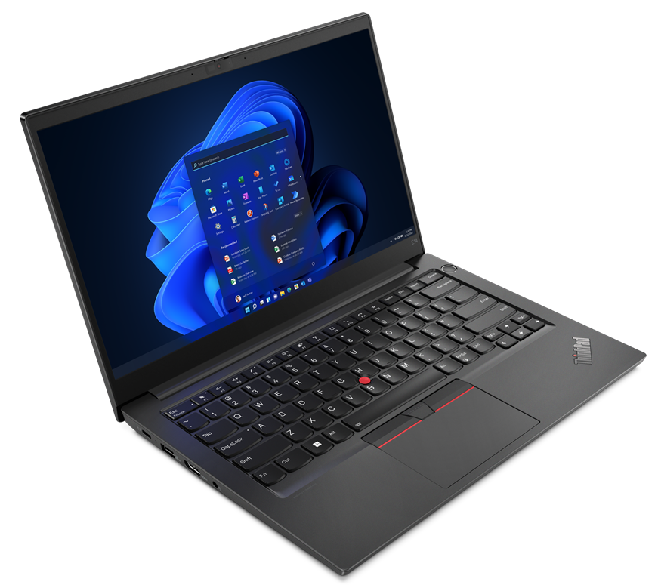
Let’s take a tour:
Can you point to:
On/Off button
Charging port
Trackpad
Trackpoint- pointing stick
Headphones port

Slide 27
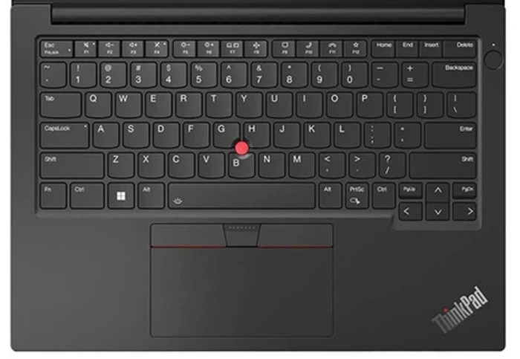

2. Press @
1.Press and hold on Shift

Slide 28
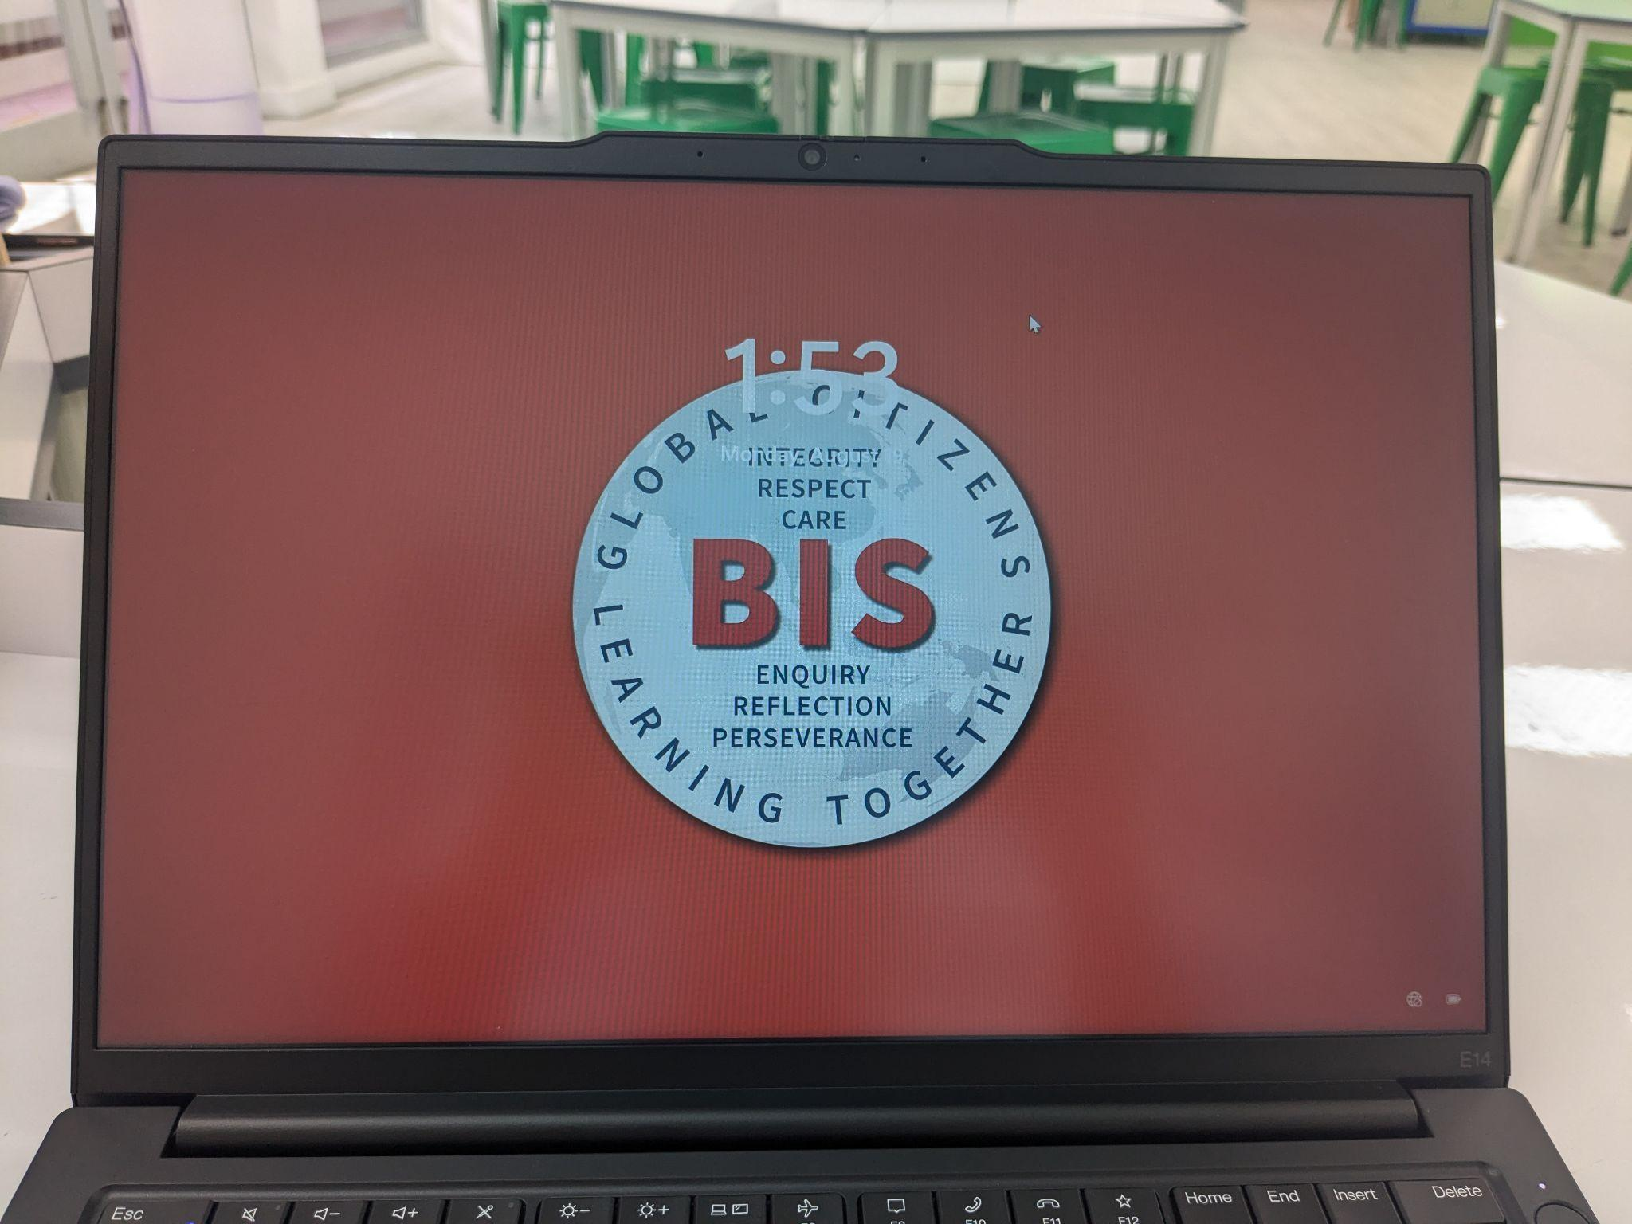
Let’s get started:
On button
Wait for BIS logo
Press Enter
Are you on the DREAMS LAB wifi?
Notes:
This will only be for your first class but the next ones may have to ‘connect’ to EDUCATION

Slide 29
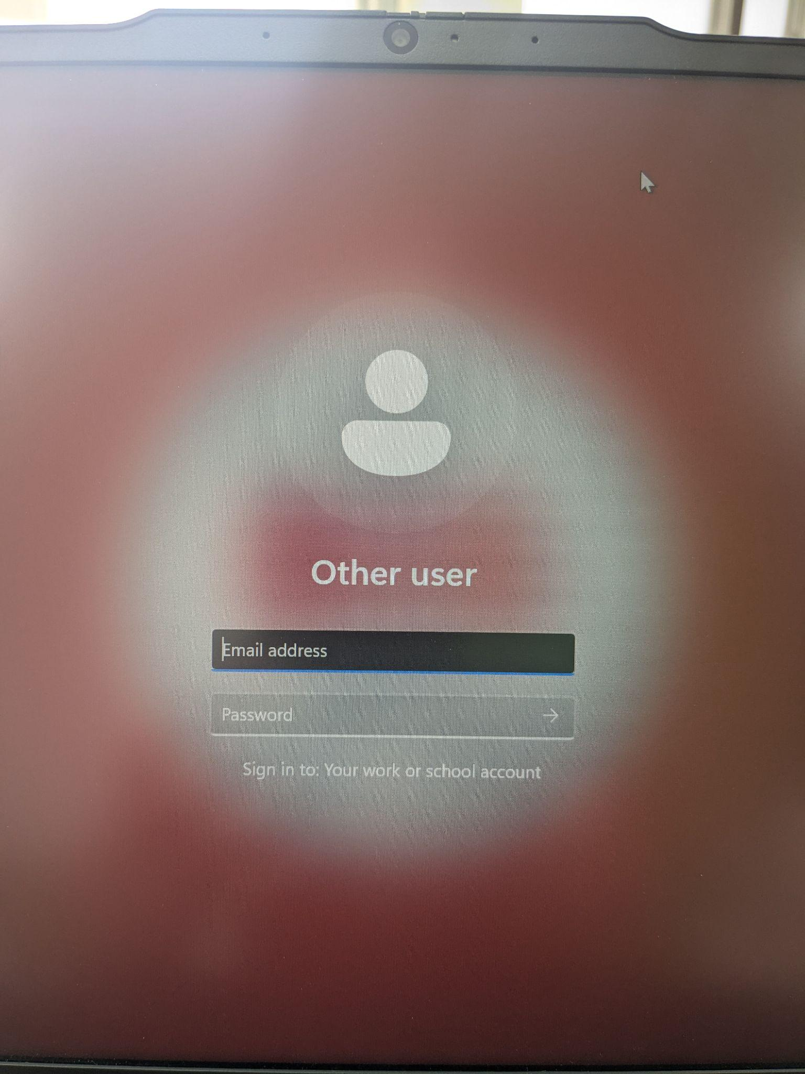
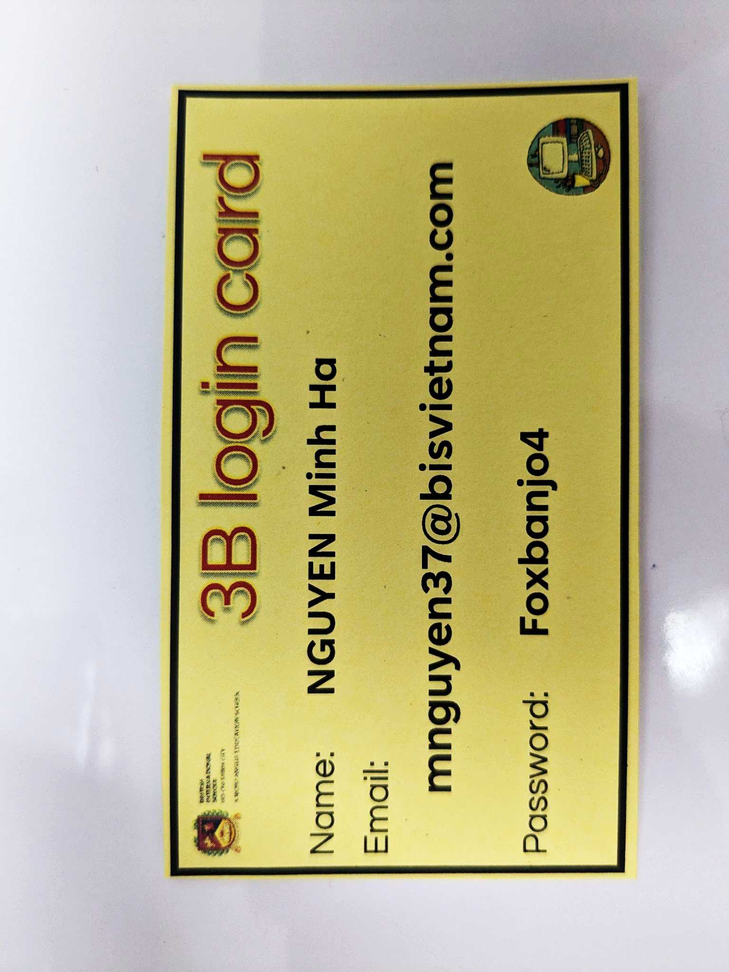
Logging in:
Login

Slide 30
Welcome to the
DREAMS Lab
Laptops

Slide 31
Meet the team
Mr Anthony
Head of ICT
Mr Patrick
Ms Rhian
Mr Tue
Ms Uyen

Slide 32
What do these look like in the DREAMS
Labs?

Slide 33
Dreams Lab Expectations

Slide 34
If…then…
…I should play on my iPad.
…I should speak loudly to my friends.
If I am waiting outside for my teacher, then….
…I should wait quietly against the wall.
…I should just go in and wait inside.
Notes:
Can stand up and go to the corner, nominate one person from each table to go to the corner or just point to the corner… depends on energy of class

Slide 35
If…then…
…. Sit and wait for someone to help me
…. I should play a random game on my iPad
If I am stuck and I don’t know what to do next, then….
….. Go and ask my Class teacher
…. C3 B4 Me
(ask 3 friends for help before asking your ICT Teacher)

Slide 36
If…then…
…. I will put my headphones in and stay quiet
…. I will stay quiet and let everyone else do the work
If I am asked to work with a partner or in a group, then….
…. I will listen to everyone and make sure everyone is involved
…. I will do all the work myself

Slide 37
If…then…
… my ICT teacher will give me 2 warnings before I need to sit out of the learning.
…. My parents will be asked to come in to school
If I am not showing respect, care and showing I am ready, then….
….. I can sing
…. I don’t need to listen in ICT, it’s ok

Slide 38
Check the Classroom Screen to see your Laptop Number!

Slide 39
Open the lid, don’t turn it on yet!
Notes:
Display Laptop number on Classroom screen

Slide 40
Let’s take a tour:
Can you point to:
On/Off button
Charging port
Trackpad
Trackpoint- pointing stick
Headphones port

Slide 41
2. Press @
1.Press and hold on Shift

Slide 42
Let’s get started:
On button
Wait for BIS logo
Press Enter
Are you on the DREAMS LAB wifi?
Notes:
This will only be for your first class but the next ones may have to ‘connect’ to EDUCATION

Slide 43
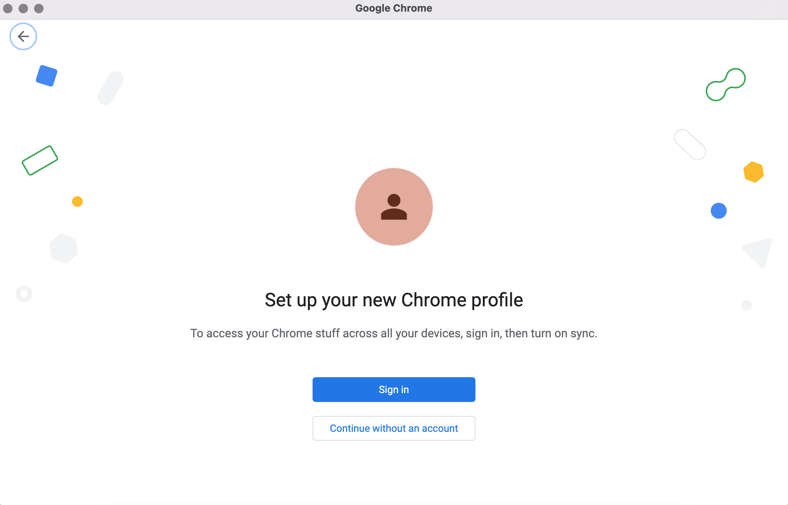

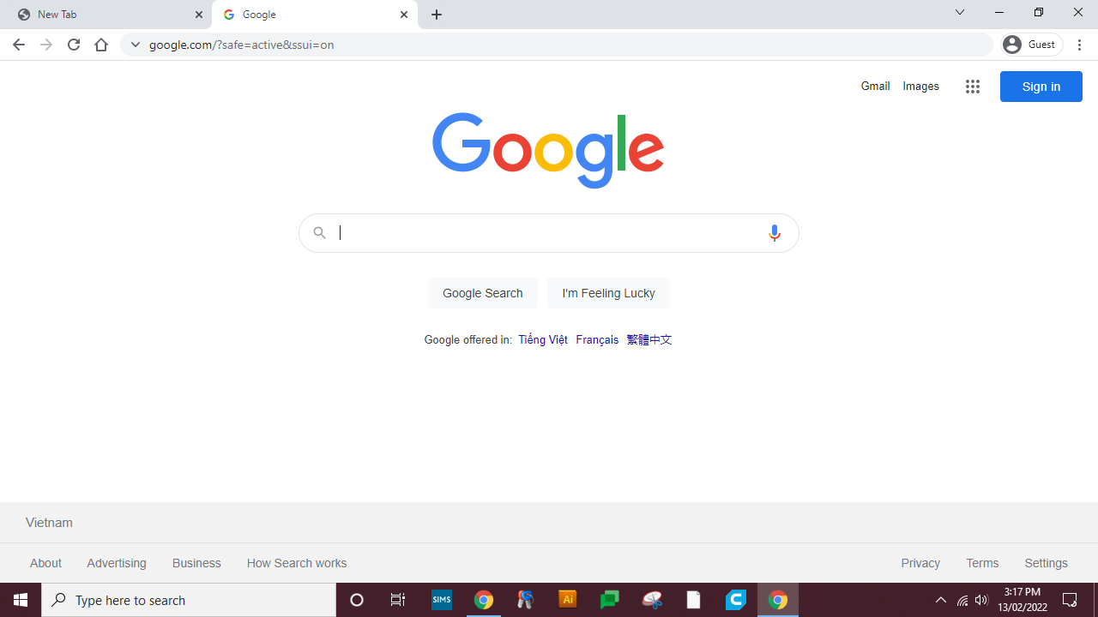
Click Here
Please make sure your language is set to English

Slide 44
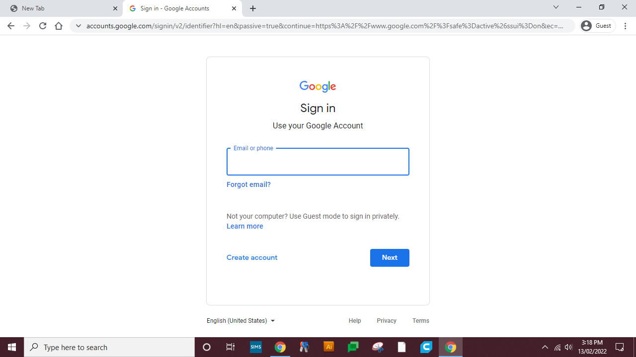
Type your Email Here

Slide 45
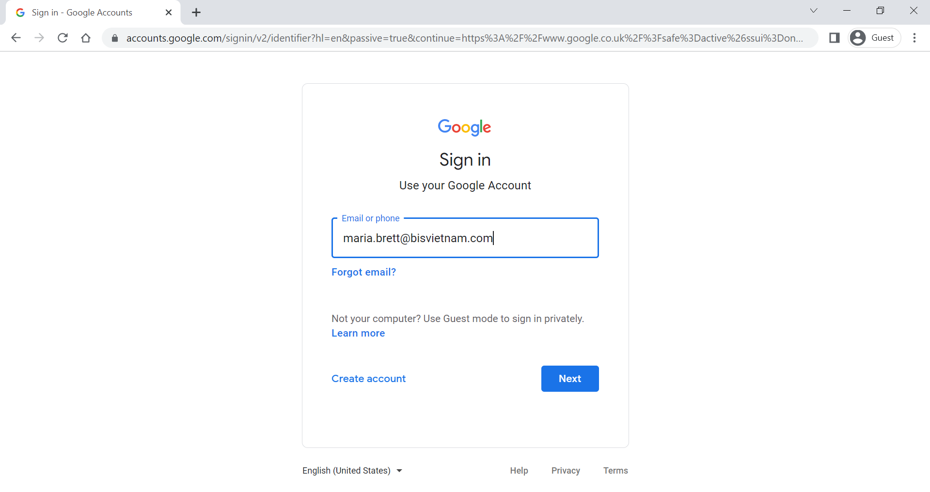
Click Here

Slide 46
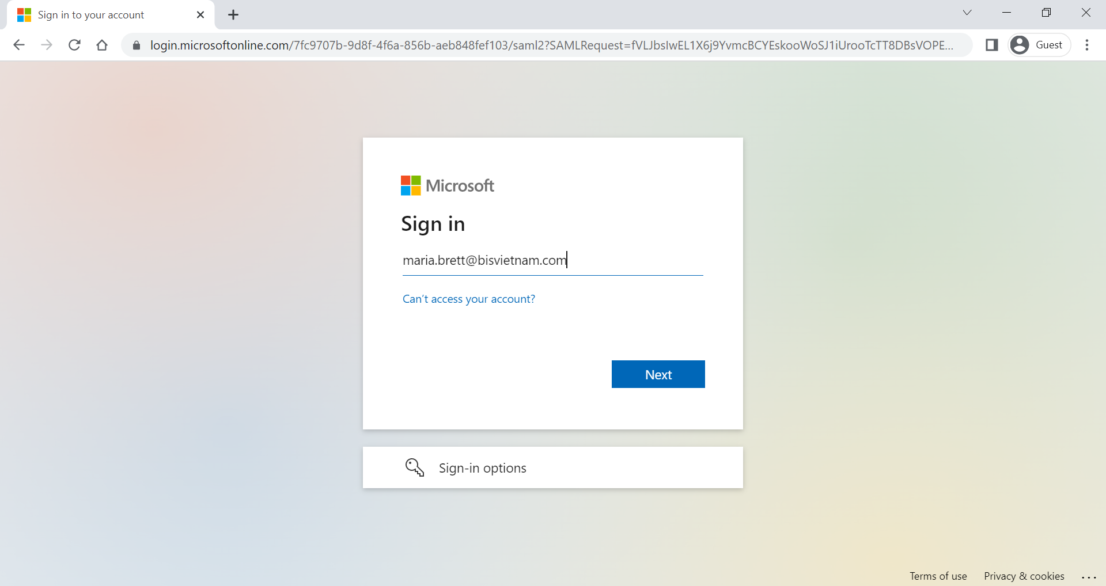
Type your Email Here

Slide 47
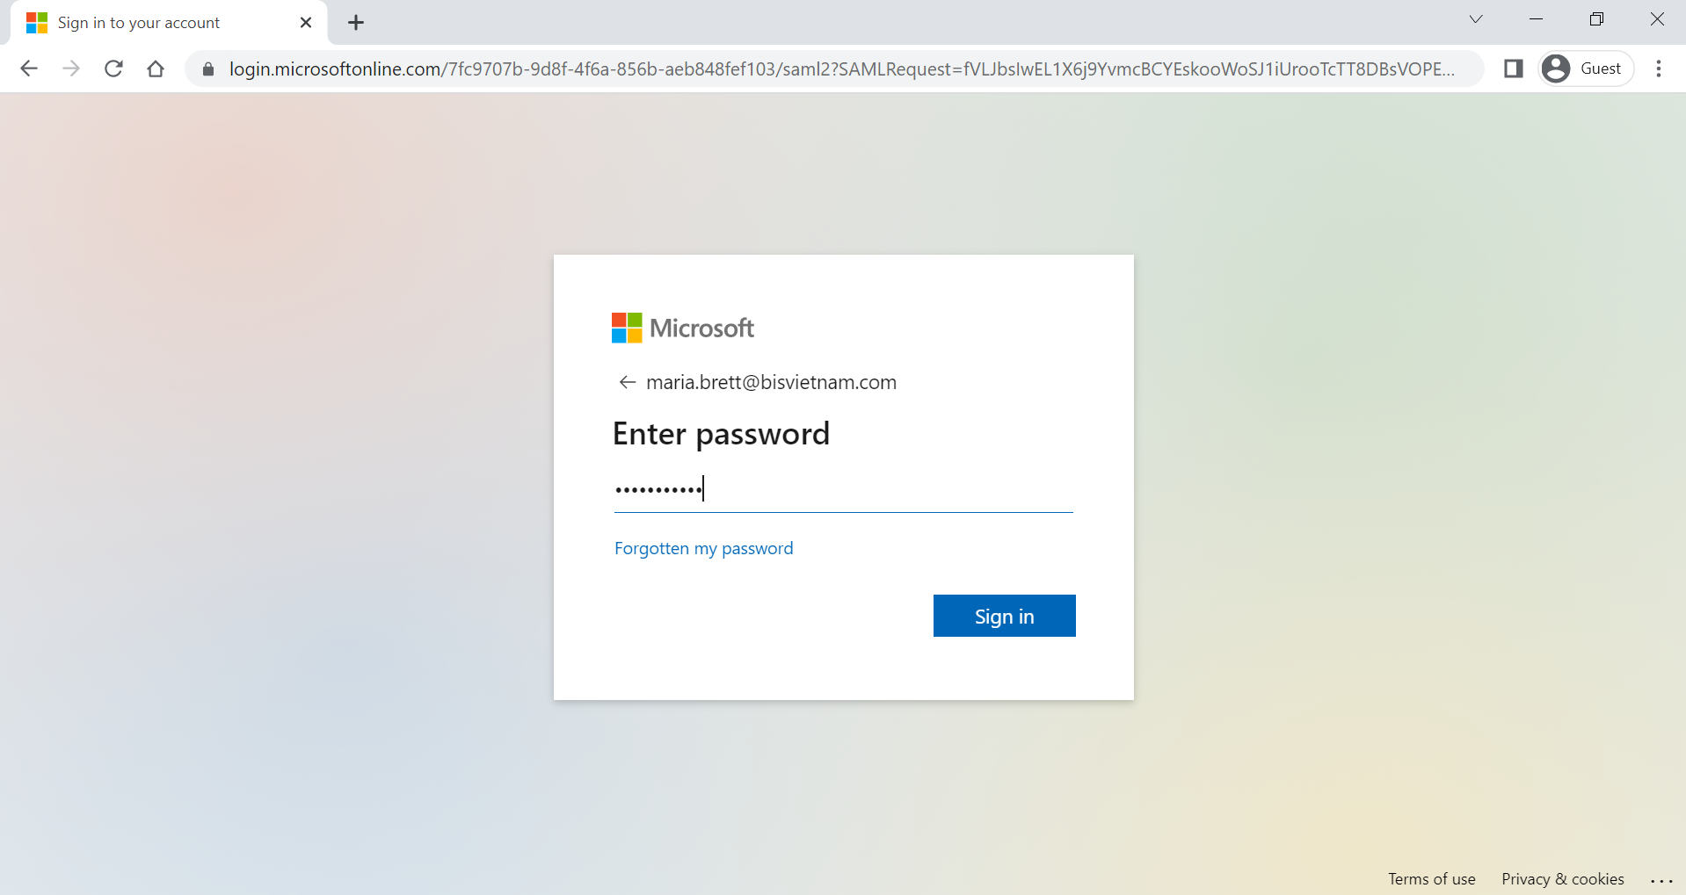
Click Here

Slide 48
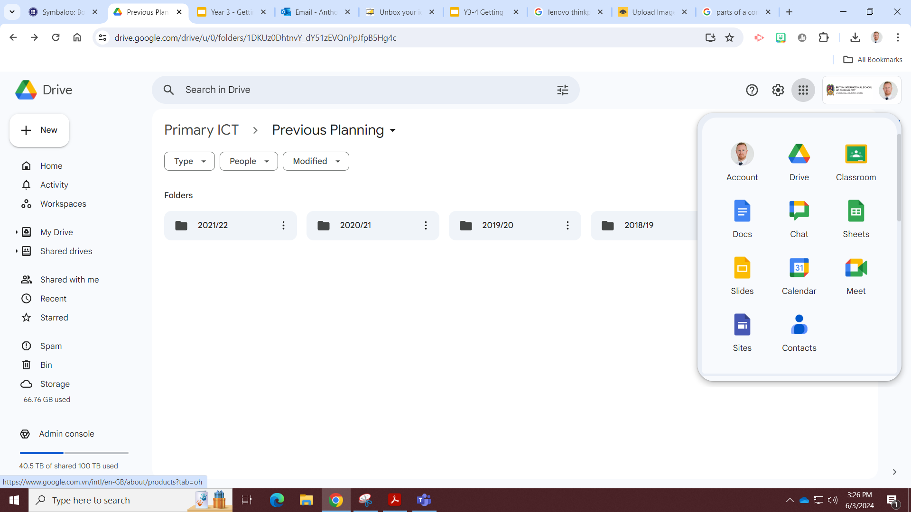
The Waffle

Slide 49
Join Google Classroom
Join Class

Slide 50
Enter class code

Slide 51
Agree and sign on Google Forms

Slide 52

Do you know how to Bookmark Google Classroom?
Notes:
Chalk and Talk

Slide 53
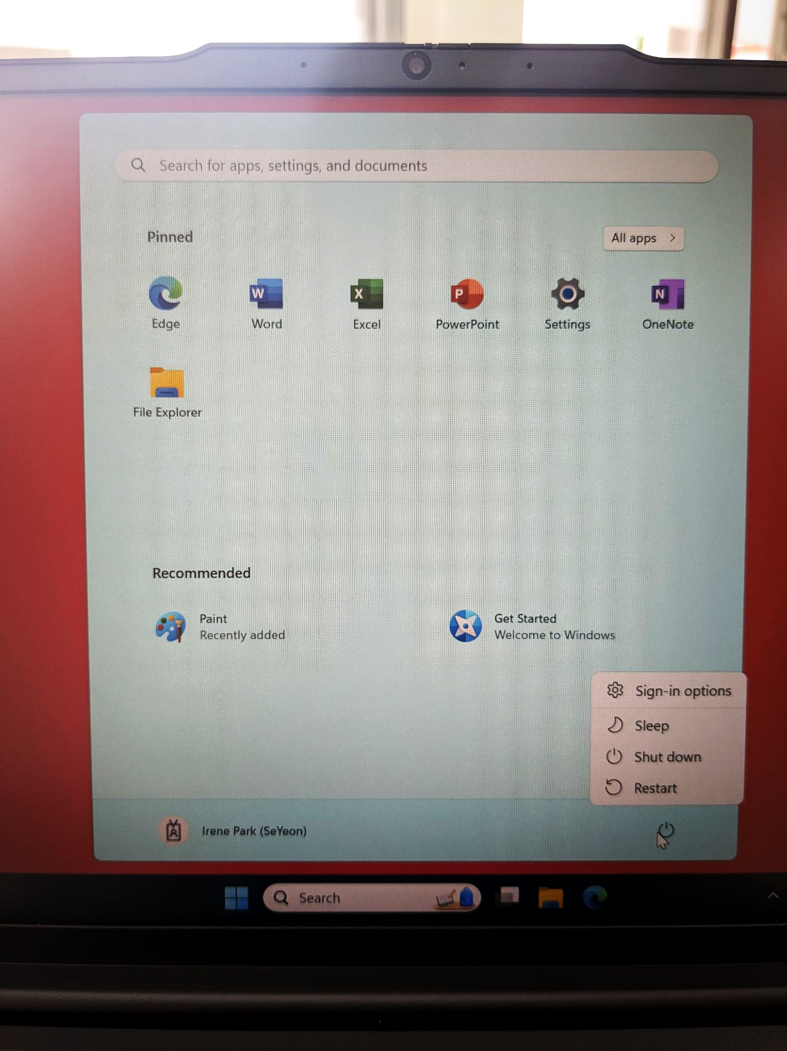
Shut down your laptop:
After every lesson please shut the laptop down so it is ready for the next person!

